Slide 1


Welcome to the class

Slide 2

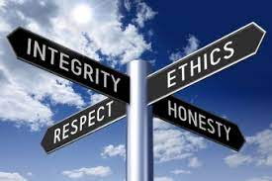
Lesson 1
Unit 5 Reading Comprehension
Sharing time
“What do you think are the noble virtues that people should have?”
2. Leading-in
Watching a clip of video - “The War against COVID-19”
3. Answer the following questions: When and where did the story take place? What do you want to convey to people by performing the play?

Slide 3
Integrity
What have we learned from the video?
The video shows us people's virtues from several aspects: Integrity, responsibility, and helpfulness. such as China has timely announced the epidemic news to the world; Doctors make every effort to treat patients; Volunteers selflessly help the public. People are following the government's instructions to actively fight the epidemic and report their travels honestly.

Slide 4

Reading Comprehension
4. Pro-reading Pair work
1) Discuss: What is the true meaning of integrity?
2) Watch the video to understand the true meaning of integrity.
https://www.youtube.com/watch?v=Z12Pd5esenE
5. While reading
Read passage 4 on page 61 of textbook and answer the questions through Kahoot!.
https://create.kahoot.it/my-library/kahoots/ed981538-de2b-4e36-9f0c-cc4f9a818c12 (Kahoot link）

Slide 5

6. Post-reading Group work
Brainstorming
1) Do you think integrity is very important for a person, a society, and
a country? Why?
2) How do you think you can become a person with integrity?
7. Presentation
Each group chooses one student to share their opinions.

Slide 6
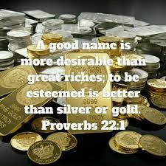
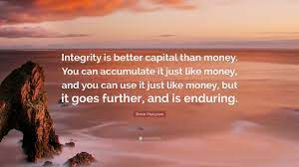
8. Conclusion
The importance of integrity
Integrity is more than simple honesty, it’s the key to success. A person with integrity can pull everything together, to make it all happen no matter how challenging the circumstances.
Learn some famous sentences about “Integrity”
A good name is better than riches. (Proverb)
Integrity is the inexhaustible knowledge, money.
If you want others to be honest, you must first be honest yourself (Shakespeare)
Integrity is the essence of mankind (Lu Xun)

Slide 7


9. Assignment
Getting ready for the presentation.
Prepare role-play according to the scenarios set by the teacher.

Slide 8

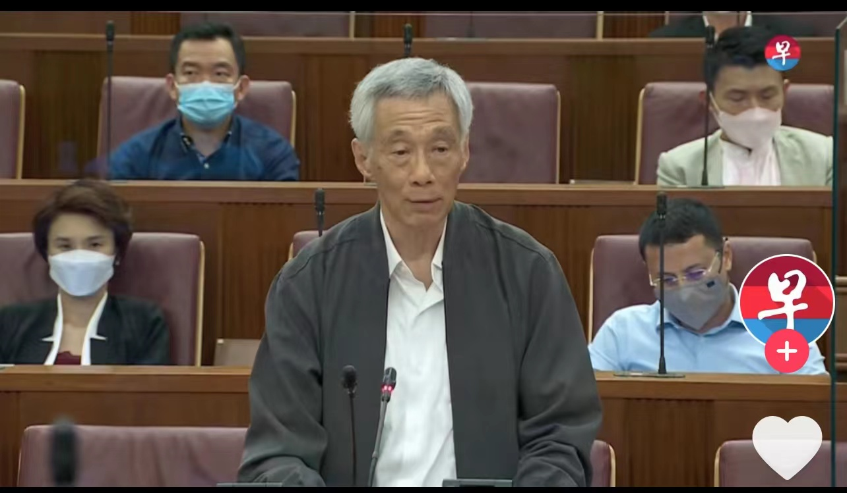

Lesson 2
Extension Lesson
Sharing time
“What do you think are the noble virtues that people should have?”
2. Leading-in
Watch two short videos and give your comments.

Slide 9
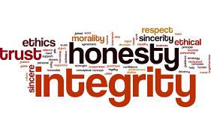
After watching the videos, we can realize:
Integrity makes society better. When we help make society better, we are rewarded with also making better our own lives and the lives of
our families and friends. Without moral conduct, society would be a miserable place.
Benefits of integrity:
- Fosters Cohesion
- Inspires Innovation
- Improves Lawmaking
- Creates Jobs
- Strengthens Leadership
- Empowers Youth

Slide 10

Role-play
Pre-task (Group work)
How do you think you can become a person with integrity?
Work in groups of four to prepare the mini-drama for 5 minutes.
(Each group chooses one scenario, makes up dialogues, and acts out the complete stories. )

Slide 11
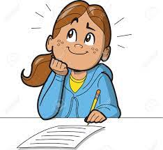
While task ---Role Play
Students perform the role-play group by group according to the scenarios set by the teacher and try to be good problem solvers.
Fill in the evaluation form while other groups are performing the play.
Role Play Assessment Form
Class _____________________ Evaluator ___________________ No. ________________
 | Group 1 | Group 2 | Group 3 | Group 4 | Group 5 | Group 6
Language using
Problem-solving methods
Problem handling capability
Smoothness
Expression
Innovative
Co-operation
Total

Slide 12
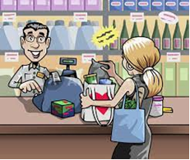
Scenario 1
Sally, Bob, and Franco want to buy some snacks, so they go into a grocery shop. Sally buys a few packs of snacks. It costs $25. She gives the cashier $50, but he gives her $35 in change. At this moment, Bob tells Sally to leave the shop quickly. Franco doesn’t agree with Bob. What will Sally do? ……

Slide 13
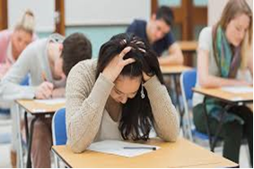
Scenario 2
Mary, Ben, Gloria, and Tom are taking an English test. Mary didn’t prepare her lesson well. She sits nervously in her seat. Her best friend Ben, who is good at English, wants to offer her help, but her other two friends, Gloria and Tom, don't think it's really helpful......

Slide 14


Scenario 3
Janice and Dori went to Hua Fa Shopping Mall last week. 5 days later, there was a news report: “Confirmed that a person with a new coronavirus infection has been to the Mall.” The school requires everyone to report on their trip for the last two weeks, but Janice and Dori are going to join a party tonight, so should they report right away or after they attend the party? Their best friends Justin and Sam give them some advice……

Slide 15
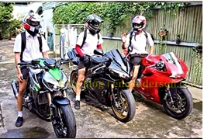
Scenario 4
Marin, Tommy, Alex, and Kent are good friends. They all like riding motorcycles, but Kent hasn't gotten his motorcycle license yet. Today is Saturday. Kent suggests that they four ride for a picnic. Marin is very excited to hear that, but Tommy and Alex have different ideas……

Slide 16
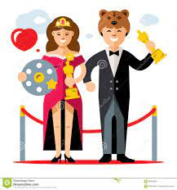
Post-task
Please give your comments about the role play according to your evaluation form.
Choose the best actor and actress.
Best actor: ___________________
Best actress： ________________

Slide 17
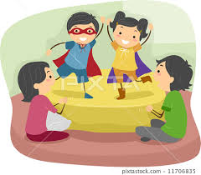
4. Conclusion
Feedback on roleplay:
Summarize the role play in terms of use of language and coping with the problems.
Provide feedback on the ability to handle things correctly.
Reiterate the importance of integrity and guide students on how to be integrity people.

Slide 18
5. Assignment
Mini writing:
Describe an integrity story of your own. How did you feel at that time? What can you do to improve your integrity?

Slide 19
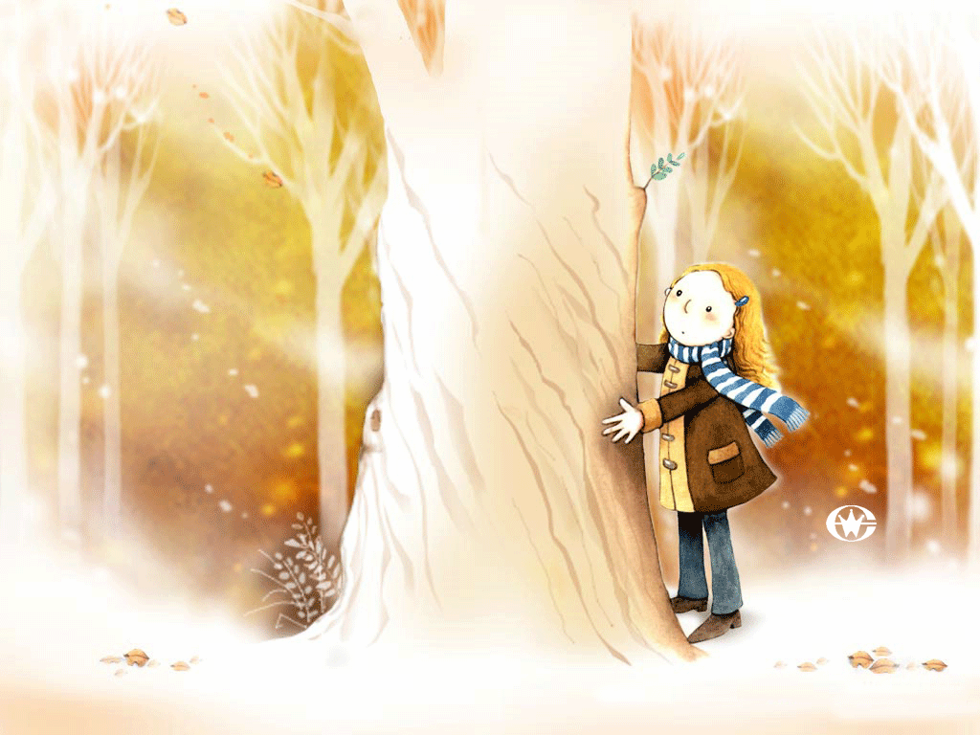

Thank you!

